Slide 1
The problem of gradient descent
Andrei caraman,
simone piperno,
leonardo skerl,
gianmarco ursini.

Slide 2
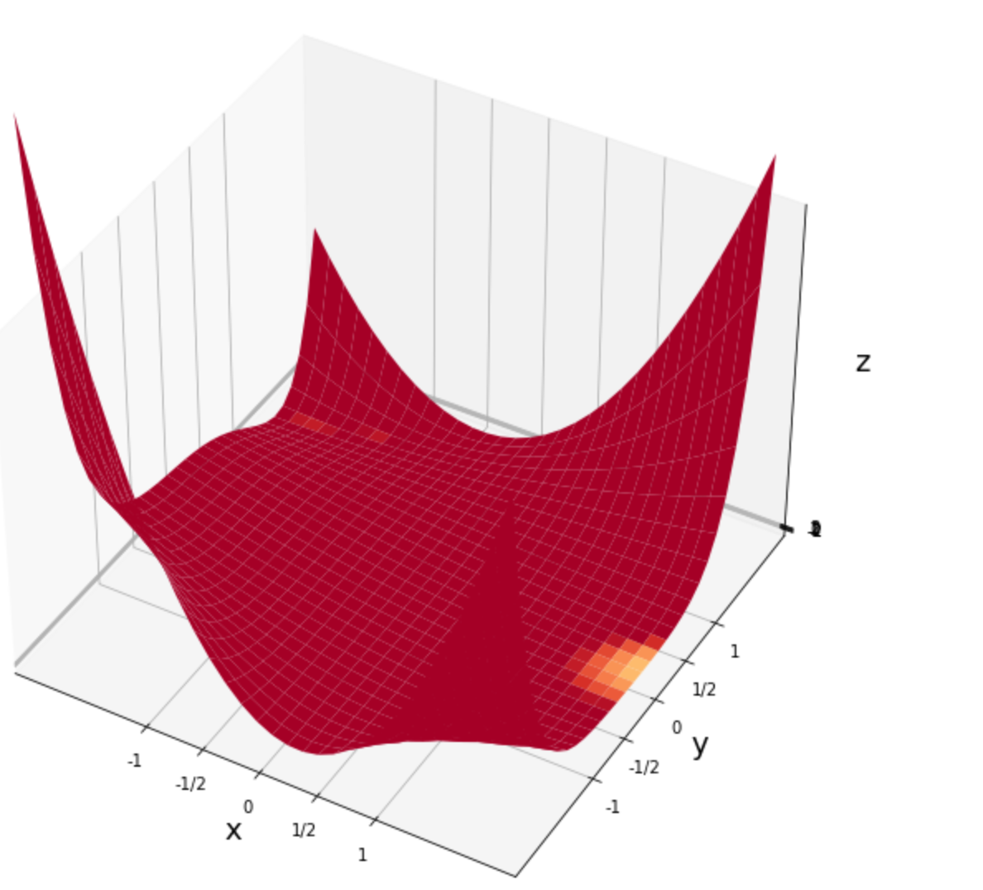
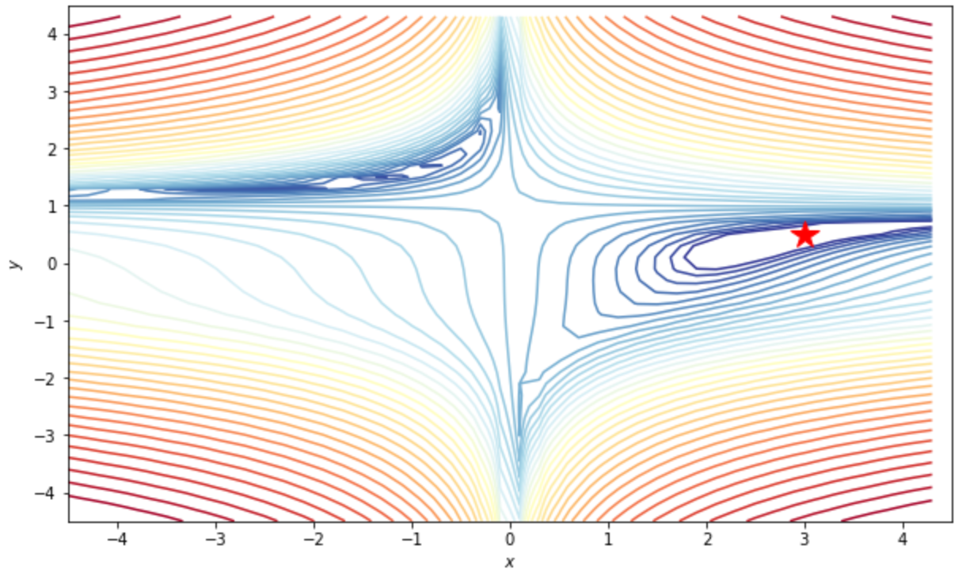
Beales function

Slide 3
RUNGE KUTTA INTEGRATORS
In numerical analysis, the Runge–Kutta methods are a family of implicit and explicit iterative methods used in temporal discretization for the approximate solutions of ODEs (ordinary differential equations).

Slide 4
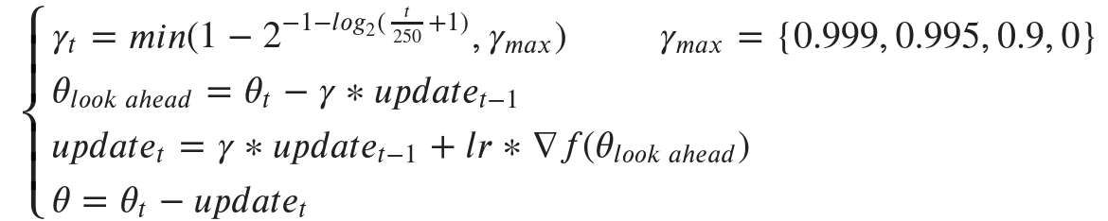
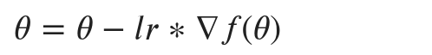
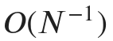
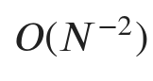
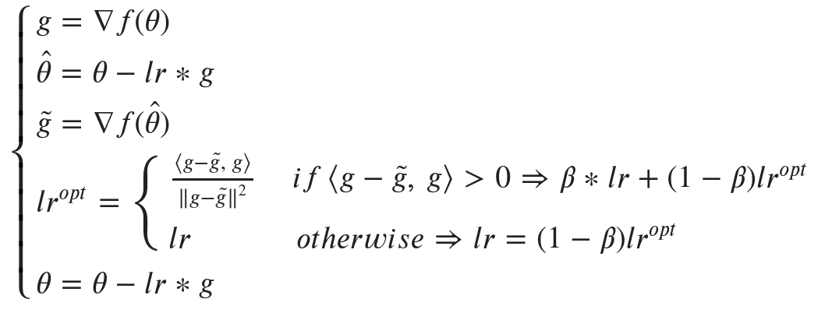
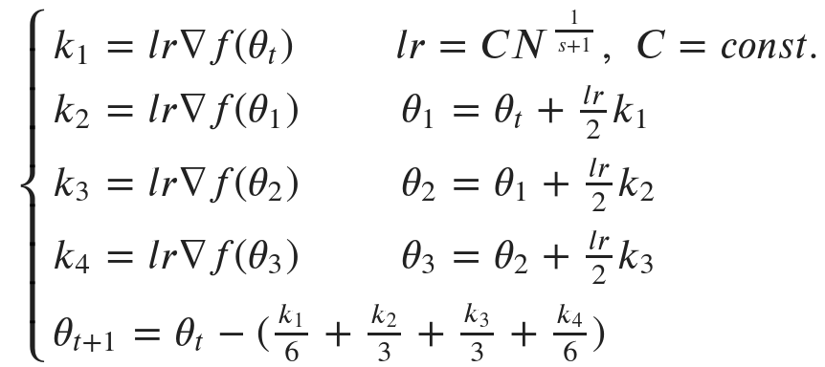
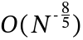
VANILLA DESCENT
NAG
RUNGE KUTTA 2 ADAPTIVE GRADIENT
RUNGE KUTTA 4
Notes:
Runge Kutta integrators in gradient descent field with learning rate computed in a suitable way (in the formula) converges to the optimal solution at the rate O(N^-2), which for Runge Kutta 4, that we implemented, is O(N^-8/5).
This method introduces a new local flatness condition for the objective function, under which Runge-Kutta discretization obtains convergence rates even faster than O(N^-2), without requiring high-order integrators. In particular, if the objective is locally flat around a minimum, by using only gradient information we can obtain a convergence rate of O(-p), where p quantifies the degree of local flatness.

Slide 5
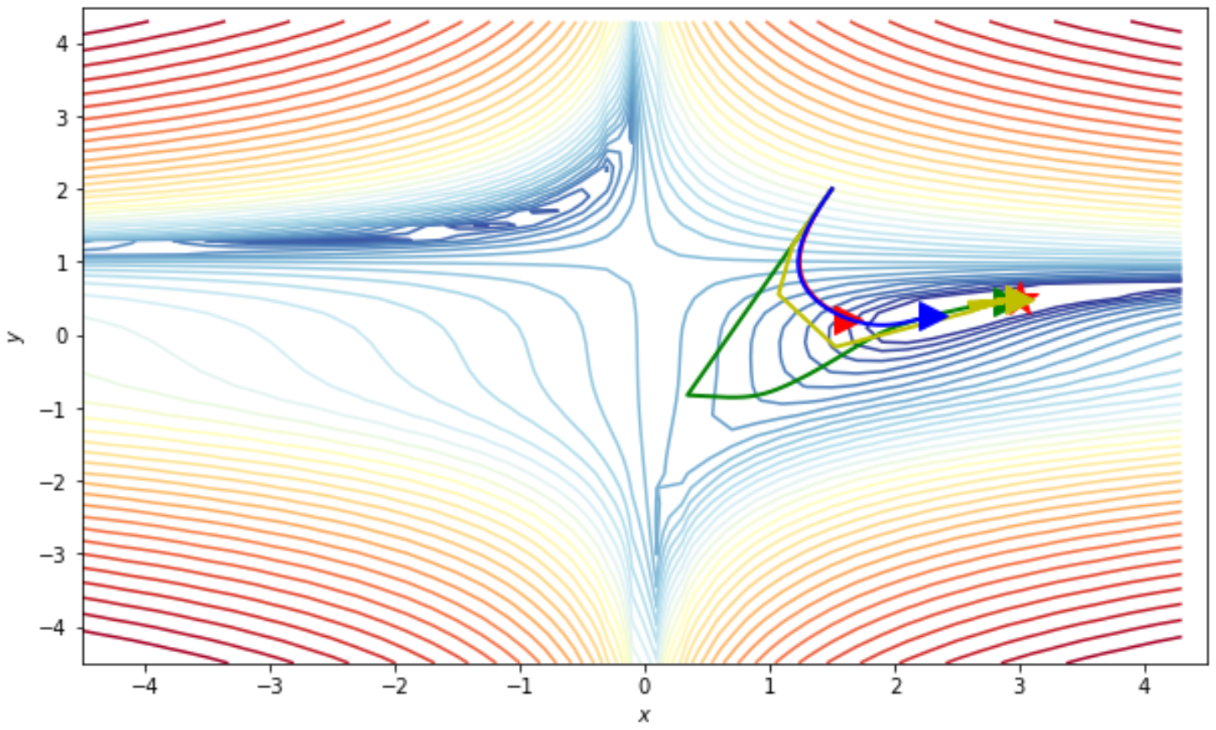
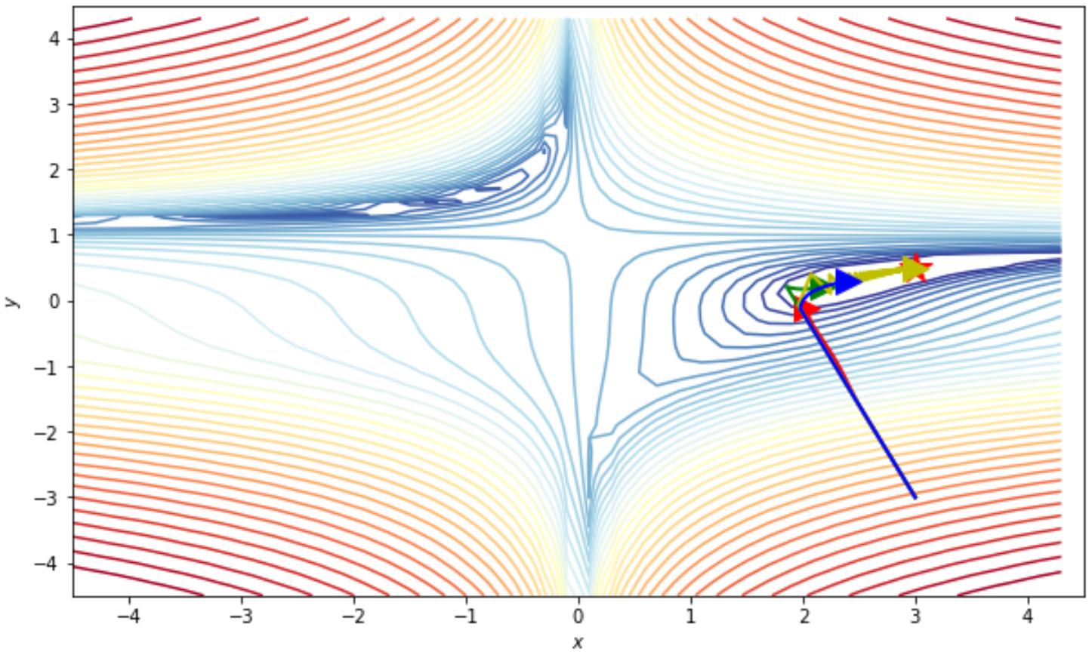
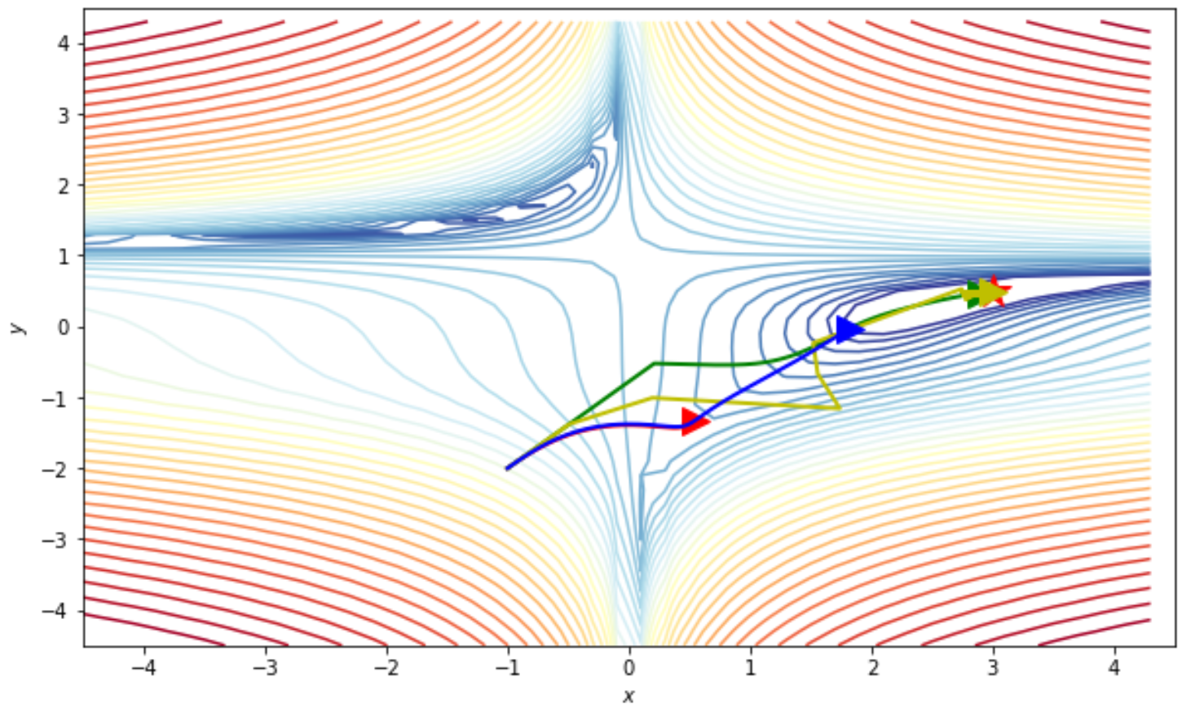
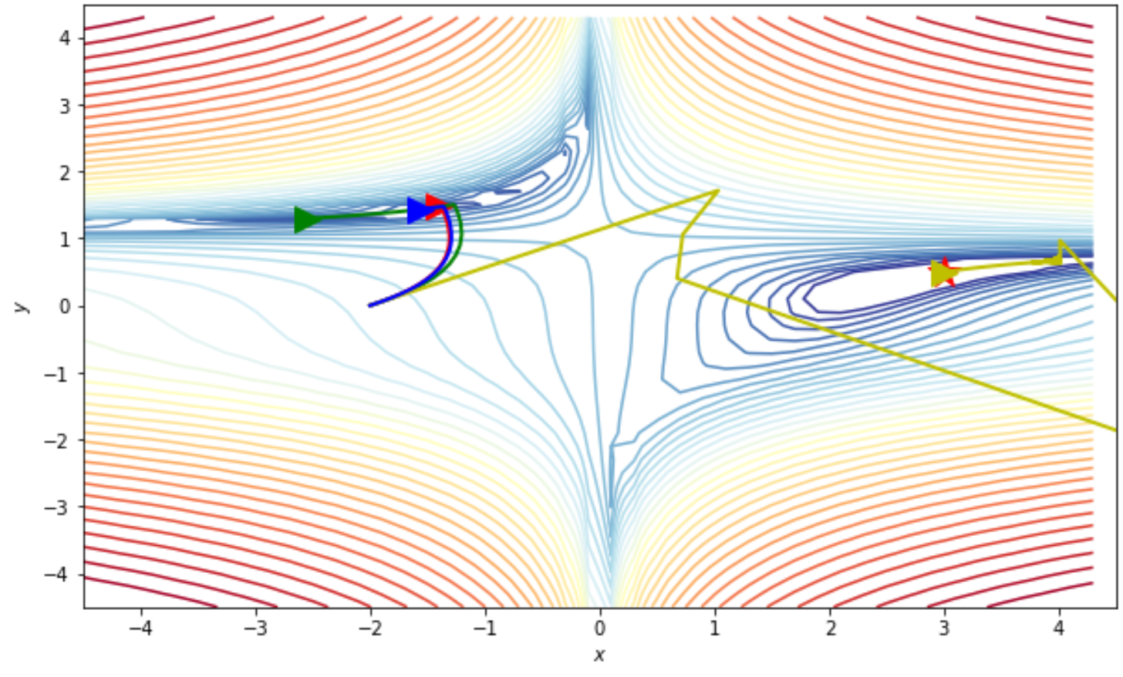
Some Testing
Red: vanilla, Yellow: RK2, Grenn: RK4, Blue: NAG

Slide 6
Now apply these gradient descent methods to the titanic dataset...

